Slide 1
Chapter 1: Introduction
(OS Structure, Modes and Services)

Slide 2

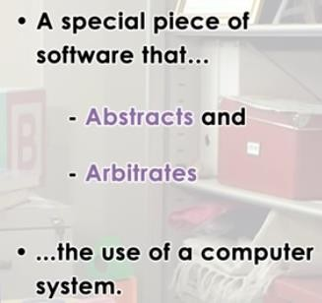

OPERATING SYSTEM?
Abstract: To simplify how hardware actually looks like.
Arbitrate: To manage , to oversee the hardware use

Slide 3

What is an Operating System?
It is a layer of system software that:
directly has privileged access to underlined hardware
hides hardware complexity
manages hardware on behalf of one or more applications according to policies.

Slide 4



What is an Operating System?
What is an Operating system?
A program that acts as an intermediate/ interface between a user of a computer and the computer hardware.
Resource allocator (Managing the resources efficiently) Control Program
Operating system goals:
Execute user programs and make problem solving easier. Make the computer system convenient to use
Efficiently use available resources
An operating system is the one program that is running at all the times on the computer- usually called the kernel.
Kernel is a program that (allow) let the hardware to recognize and
read the program/process.

Slide 5
Computer System Structure
Computer system can be divided into four components:
Hardware – provides basic computing resources
CPU, memory, I/O devices
Operating system
Controls and coordinates use of resources among various applications and users
System/Application programs – define the ways in which the system resources are used to solving user problems
Word processors, compilers, web browsers, database systems, video games
Users
People, machines, other computers

Slide 6
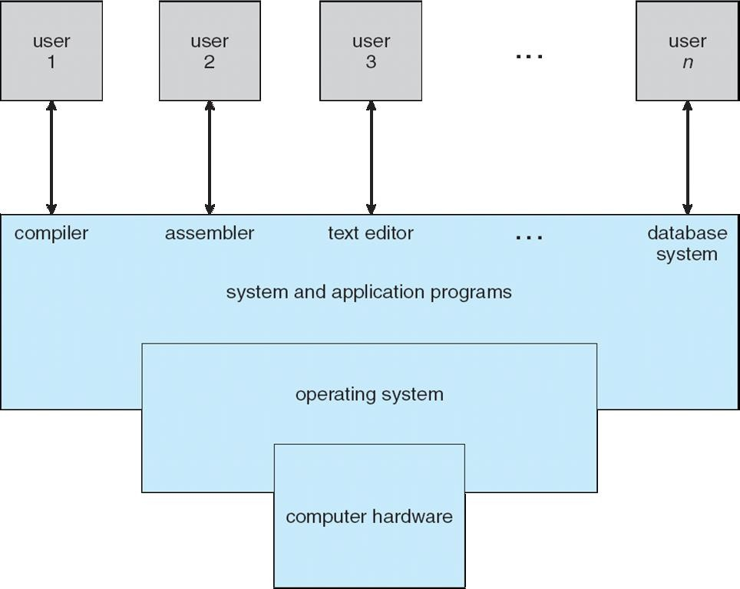
Four Components of a Computer System

Slide 7
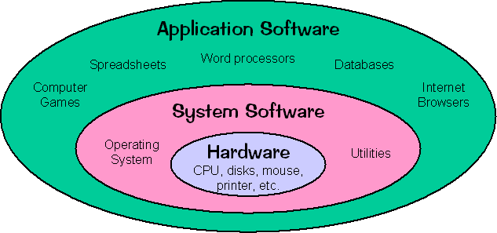

Slide 8
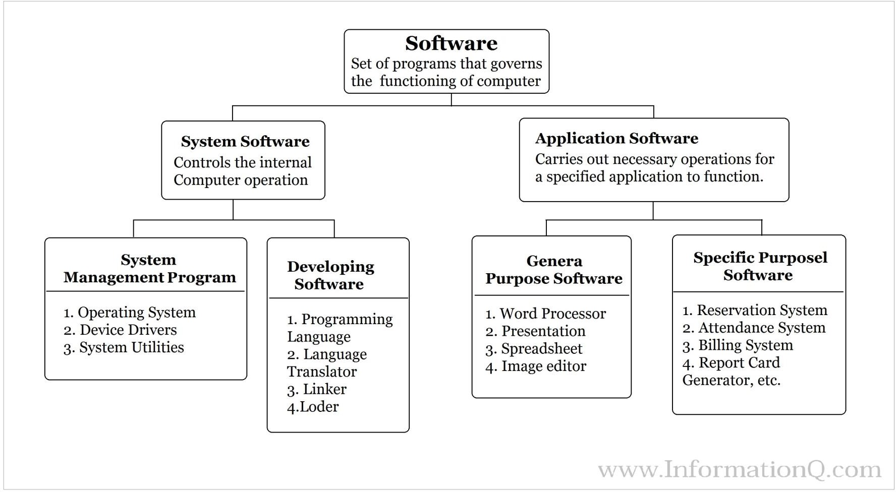

Slide 9
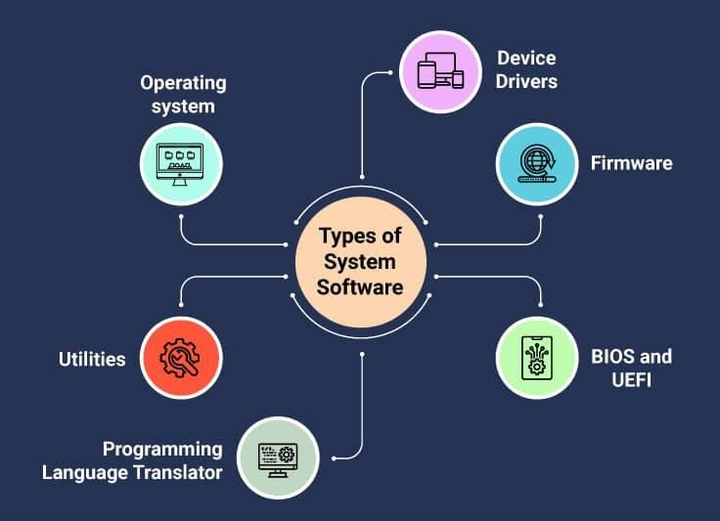

Slide 10
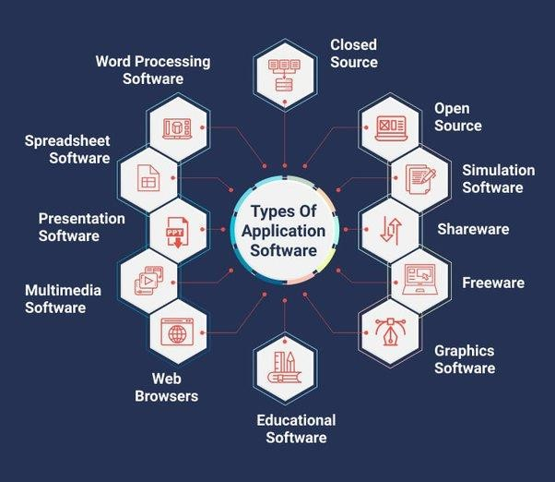

Slide 11
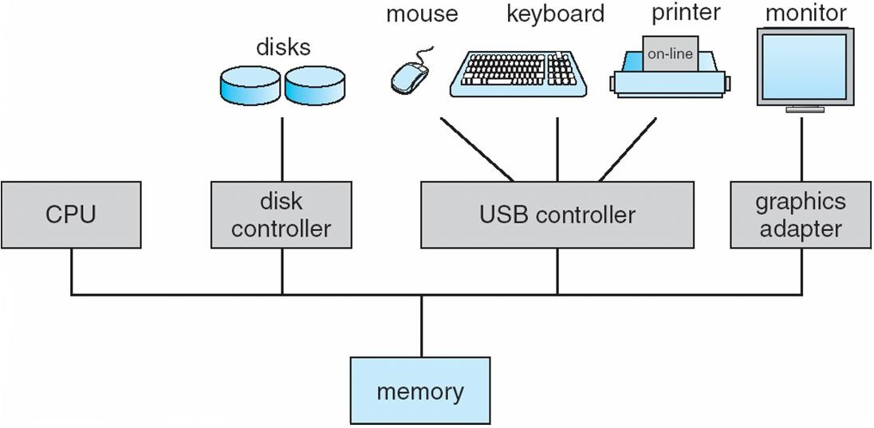
Computer System Organization
Computer-system operation
One or more CPUs, device controllers connect through common bus providing access to shared memory
Concurrent execution of CPUs and devices competing for memory cycles

Slide 12
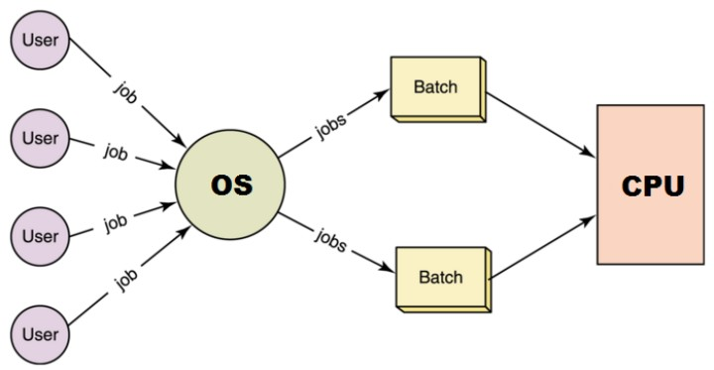
TYPES OF OS
Batch Systems
“Batch operating system. The users of a batch operating system
do not interact with the computer directly.
Each user prepares his job on an off-line device like punch cards and submits it to the computer operator.
To speed up processing, jobs with similar needs are batched
together and run as a group”.
*[https://www.tutorialspoint.com/operating_system/os_types.htm]

Slide 13

TYPES OF OS: Batch Systems
There is no direct interaction between user and the computer.
The user has to submit a job (written on cards or tape) to a computer operator.
Then computer operator places a batch of several jobs on an input
device.
Jobs are batched together by type of languages and requirements.
Then a special program, the monitor program, manages the execution of each program in the batch.
The monitor program is always in the main memory and available for
execution.
Disadvantages:
No interaction between user and computer.
No mechanism to prioritize the processes

Slide 14
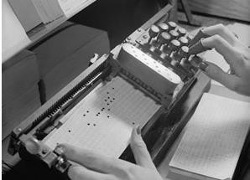
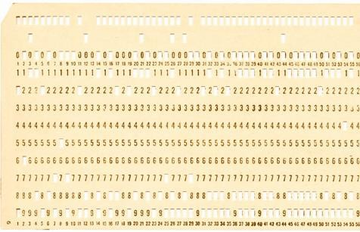
TYPES OF OS: Batch Systems
Early computers were machines run from a console
The common input devices were card readers and tape drives.
The common output devices were line printers, tape drives, and card punches.
To speed up processing, operators batched jobs with similar needs
together and ran them through the computer as a group.
User Prepares a JOB (Program) using Punch Cards → Computer
Operator→ Wait for Output

Slide 15


Multiprogrammed OS
Multiprogramming: When 2 or more processes reside in memory at the same time
Single user processes cannot keep CPU and I/O devices busy at all times
Multiprogramming organizes jobs (code and data) so CPU always has one to execute
Multiprogramming assumes a single shared processor. One
job selected and run via job scheduling
Multiprogramming increases CPU utilization.
It is mixture of I/O bound and CPU bound processes

Slide 16


Multiprogrammed OS
In this the operating system picks up and begins to execute
one of the jobs from memory.
Once this job needs an I/O operation operating system
switches to another job (CPU and OS always busy).
Jobs in the memory are always less than the number of jobs
on disk(Job Pool).

Slide 17
Multiprogrammed OS
If several jobs are ready to run at the same time, then the system chooses which one to run through the process of CPU Scheduling.
In Non-multiprogrammed system, there are moments when
CPU sits idle and does not do any work.
In Multiprogramming system, CPU will never be idle and
keeps on processing.

Slide 18


Multitasking/Timesharing OS
Timesharing executed by between them.
(multitasking) when multiple jobs are the CPU simultaneously by switching
There is at least one program is executing in memory
🢡process
If several jobs ready to run at the same time 🢡 CPU
scheduling
If processes don’t fit in memory, swapping moves
them in and out to run
Only one CPU is involved, but it switches from one process to another so quickly that it gives the appearance of executing all of the processes at the same time.

Slide 19
Multitasking/ Time Sharing
Types of Multitasking:
Preemptive: the operating system parcels CPU time slices to each program.
Cooperative: each program can control the CPU for as long
as it needs it.
If a program is not using the CPU, however, it can allow
another program to use it temporarily.
In time sharing systems the prime focus is on minimizing the response time, while in multiprogramming the prime focus is to maximize the CPU usage.

Slide 20
Multiprocessing OS
A multiprocessor system consists of several processors that share a common physical memory.
Multiprocessor system provides higher computing power and speed.
In multiprocessor system all processors operate under single operating system.

Slide 21
Multiprocessing OS
Multi-processor systems; that is, they have multiple
CPU.
Also known as parallel systems or tightly coupled systems
Such systems
have
sharing
more than one
the computer bus, the clock, and
processor in close
communication,
sometimes memory and peripheral devices.

Slide 22
Distributed Systems
A network is a communication path between two or more
systems.
Each system over the network keeps copy of the data, and this leads to Reliability (Because if one system crashes , data is not lost).
CLIENT SERVER SYSTEMS
PEER TO PEER SYSTEMS

Slide 23
Real Time Systems
Time bound systems
Real time systems are of 2 types:
Soft Real time Systems: Process should complete in specific time but May have some delay (Positive delay) and will not harm the system.
Exp: Session expires but can be re-logged in.
Hard Real Time Systems: Each process is assigned a specific time instance, and Process must complete in that time otherwise system will crash.

Slide 24
Real Time Embedded Systems
is a computing environment that reacts to input within
a specific time period.
Time Driven
Task specific
Exp: Microwave, Washing Machine…

Slide 25
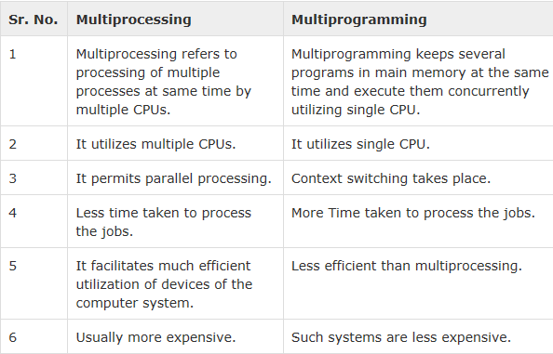

Slide 26
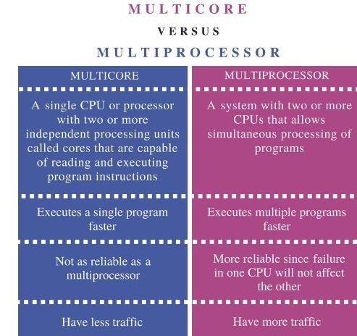

Slide 27
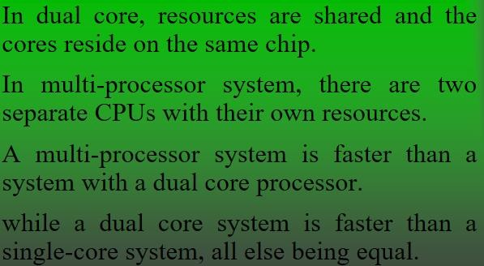

Slide 28
Operating System Views
OS can be explored from 2 view points:
1. User view:
The goal of the Operating System is to maximize the work and minimize the effort of the user.
Operating System gives an effect to the user as if the processor is dealing only with the current task, but in background processor is dealing with several processes.

Slide 29


Operating System Views
OS can be explored from 2 view points:
2. System View:
Operating System is a program involved with the hardware.
OS is a resource allocator
Allocates and Manages all resources and their sharing.
Decides between conflicting requests for efficient and fair resource use
OS is a control program
Controls execution of programs to prevent errors and improper use of the computer
It prevents improper usage, error and handle deadlock
conditions.

Slide 30
Operating-System Operations
OS’s are Interrupt driven. If no process, no I/o devices, No users then OS will sit quietly waiting for some event to occur.
Program or software send, Generate Events by using system calls. Error or request by a software creates exception or trap
E.g. Division by zero
To ensure proper execution of OS, we must distinguish between execution of OS code and user defined code.

Slide 31
Operating-System Operations
To protect OS, Dual-mode operations exist:
User mode (1) and kernel mode (0)
A Mode bit is added to hardware to indicate mode
Provides ability to distinguish when system is running user mode or kernel mode
System call changes mode to kernel, return from call resets it to user

Slide 32
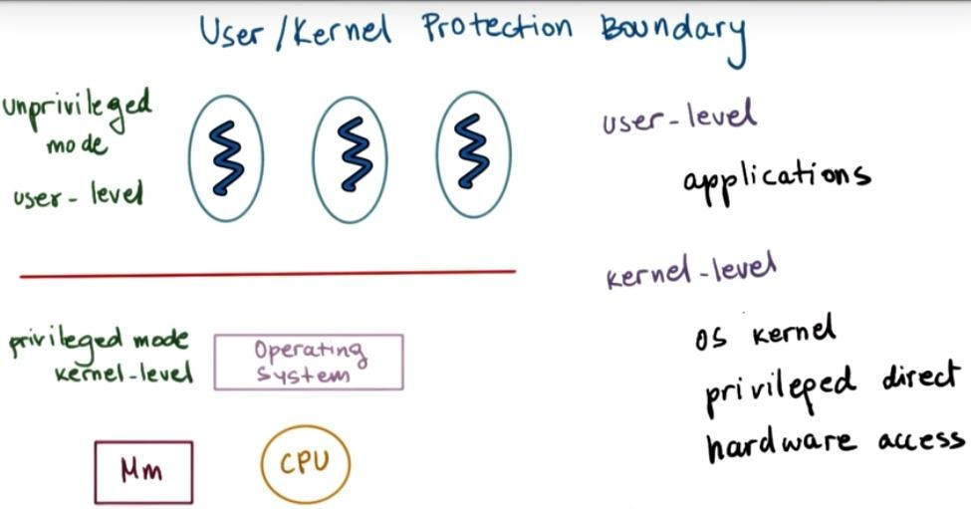
User/Kernel Protection Boundary

Slide 33
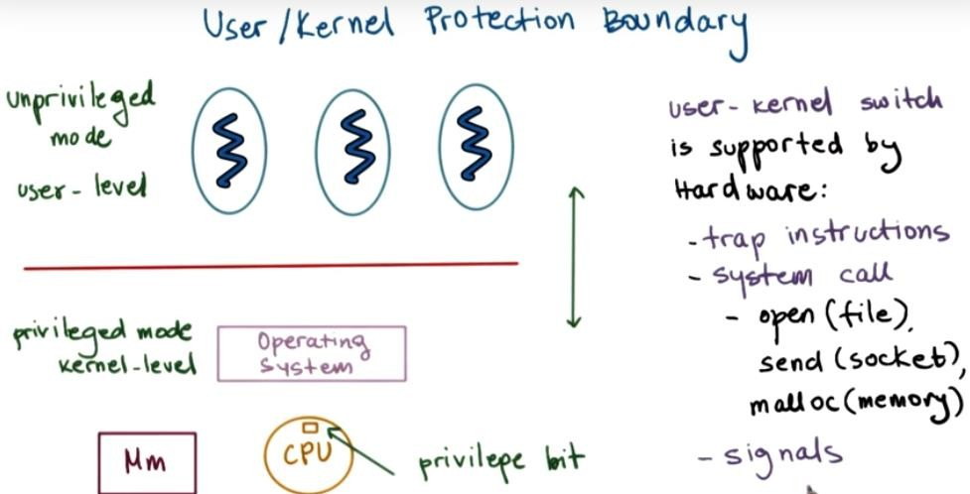
User/Kernel Protection Boundary

Slide 34
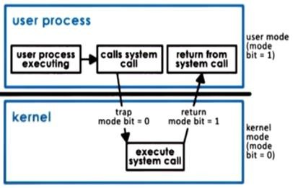
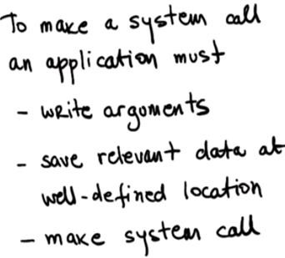
Transition from User to Kernel Mode

Slide 35
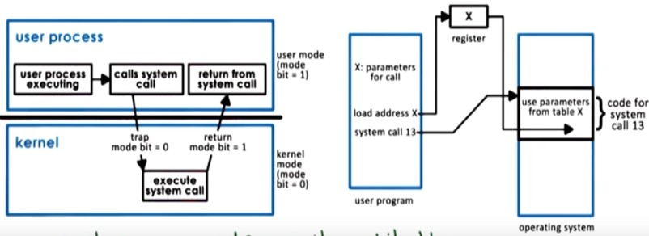
Transition from User to Kernel Mode

Slide 36
Operating System Structure
Various ways to structure a system

Slide 37
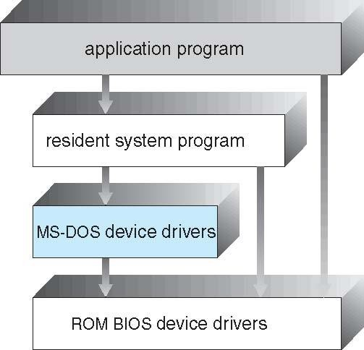

Simple Structure -- MS-DOS
MS-DOS – written to provide the most functionality in the least space
Not divided into modules
Although MS-DOS has some structure, its interfaces and levels of functionality are not well separated

Slide 38
Non Simple Structure -- UNIX
The UNIX OS consists of two parts: System programs
The kernel
Consists of everything below the system-call
interface and above the physical hardware
Provides the file system, CPU scheduling, memory management, and other operating-system functions; a large number of functions for one level

Slide 39
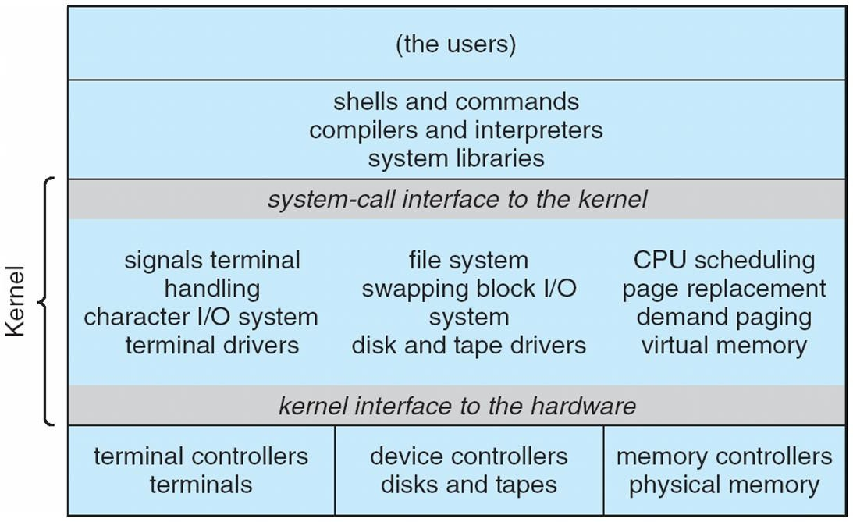
Traditional UNIX System Structure

Slide 40
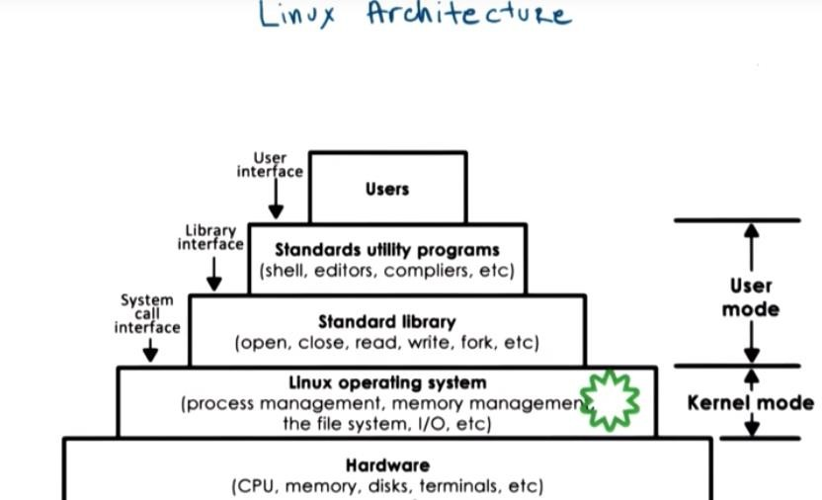
Traditional LINUX System Structure

Slide 41
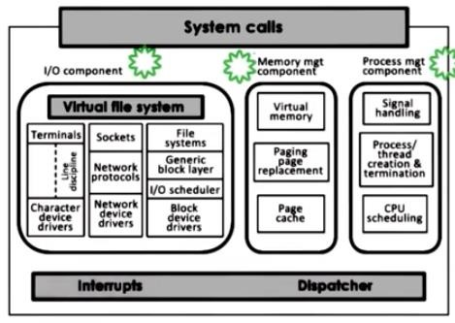
Kernel has many inbuilt modules

Slide 42
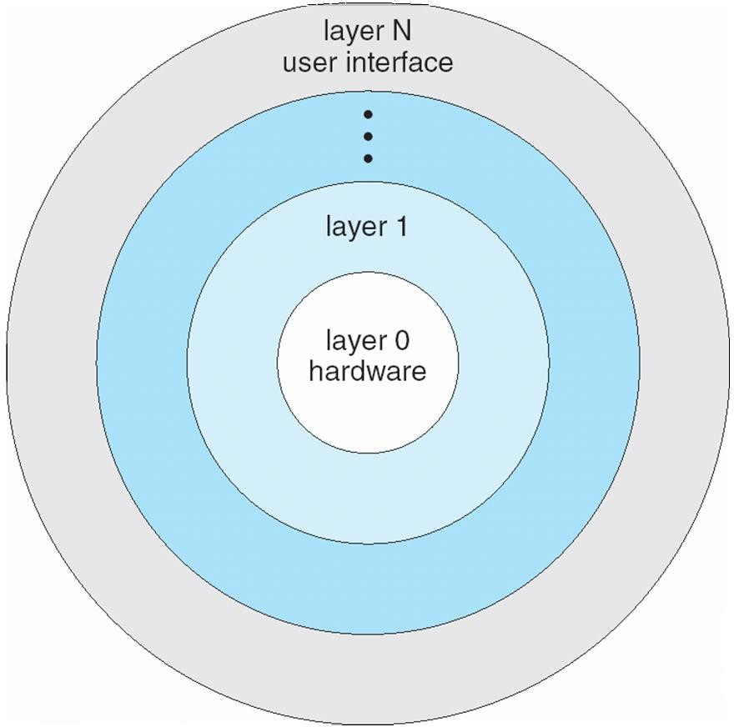
Layered Approach
The operating
system is number of
divided into a
layers (levels), each built on top of lower layers. The bottom layer (layer 0), is the hardware; the highest (layer N) is the user interface.
W ith modularity, laye
rs are
selected such that uses functions
each
(operations) and services of only lower-level layers

Slide 43
Disadvantage
Designing difficulties which layer will top of the layer and which will be below. because a layer can only use the services of layers which are below them.
Example:>
Let it be we are having a layer which deals with backing storage,layer uses the disk ,space used by virtual memory algo.Now for this layer we have to make sure that it is below the layer which deals with memory management as memory management routine needs to find the services provided by backing storage layer
Not very sufficient as for accessing something so the system call has i has to go through all the below layers to get the access

Slide 44

Modular
Modules are similar to layers in that each subsystem has clearly defined tasks and interfaces, but any module is free to contact any other module, eliminating the problems of going through multiple intermediary layers,
The kernel is relatively small in this architecture, similar to microkernels, but the kernel does not have to implement message passing since modules are free to contact each other directly.

Slide 45
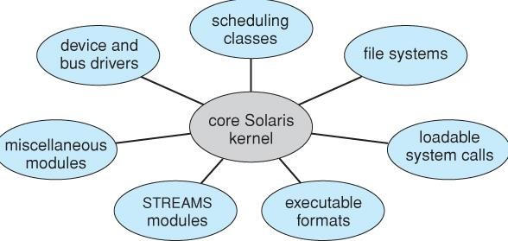

Slide 46

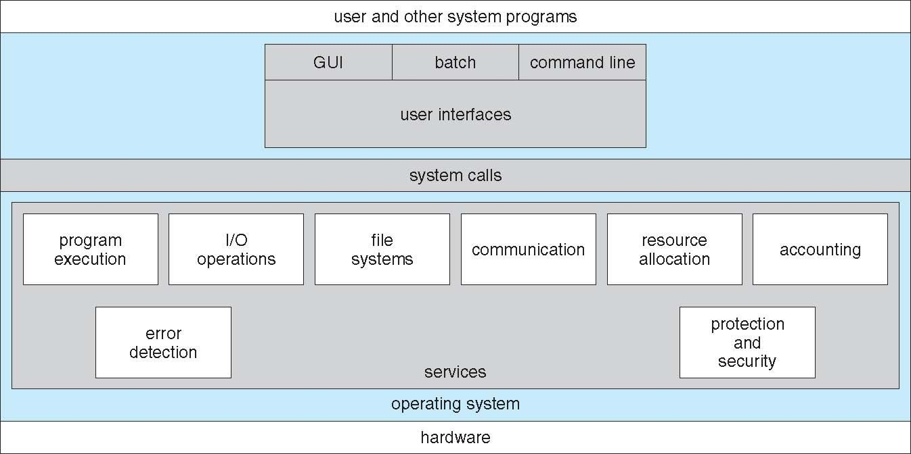
Operating System Services
An operating system provides an environment for the programs to run.
It provides certain services to programs

Slide 47
Operating System Services
Operating-system services provides functions that are helpful to the user:
User interface - Almost all operating systems have a user interface (UI)
 Varies between Command-Line (CLI), Graphics User
Interface (GUI).
Program execution - The system must be able to load a program into memory and to run that program, end execution, either normally or abnormally (indicating error)
I/O operations - A running program may require I/O, which may involve a file or an I/O device.
File-system manipulation - read and write files and directories, create and delete them, search them, list file Information, permission management.

Slide 48
Operating System Services
Communications – Processes may exchange information, on the same computer or between computers over a network
Communications may be via shared memory or through message passing (packets moved by the OS)
Error detection – OS needs to be constantly aware of possible errors
May occur in the CPU and memory hardware, in I/O devices, in user program
For each type of error, OS should take the appropriate action to ensure correct and consistent computing
Debugging facilities can greatly enhance the user’s and programmer’s abilities to efficiently use the system.
Resource allocation – OS must ensure allocation of resources to all programs running.
Many types of resources - such as CPU cycle time, main memory, and file storage, I/O devices

Slide 49
Operating System Services
Accounting - To keep track of which users use how much and what kinds of
computer resources.
Protection and security - The owners of information stored in a multiuser or networked computer system may want to control use of that information, concurrent processes should not interfere with each other
Protection involves ensuring that all access to system resources is controlled
Security of the system from outsiders requires user authentication, extends to defending external I/O devices from invalid access attempts
If a system is to be protected and secure, precautions must be instituted throughout it.
A chain is only as strong as its weakest link.

Slide 50
Kernel
A kernel is a central component of an operating system.
It acts as an interface between the user applications and the hardware.
The sole aim of the kernel is to manage the communication between the software (user level applications) and the hardware (CPU, disk memory etc).
The main tasks of the kernel are :
Process management Device management Memory management
Interrupt handling
I/O communication File system...etc..

Slide 51
Kernel
A kernel is the lowest level of software that interfaces with the hardware in your computer.
It is responsible for interfacing all applications that are running in “user mode” down to the physical hardware, and allowing processes, to get information from each other using inter-process communication (IPC).

Slide 52
Kernel Types
kernels fall into one of three types:
Monolithic Microkernel Hybrid

Slide 53
Monolithic Kernel
A monolithic kernel is an operating system architecture where the entire operating system (which includes the device drivers, file system, and the application IPC etc.) is working in kernel space, in supervisor mode.
Monolithic kernels are able to dynamically load (and unload)
executable modules at runtime.
Examples of operating systems that use a monolithic kernel are - Linux, Solaris, OS-9, DOS, Microsoft Windows (95,98,Me) etc.

Slide 54
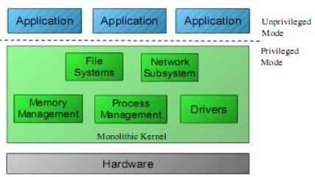
Monolithic Kernel

Slide 55
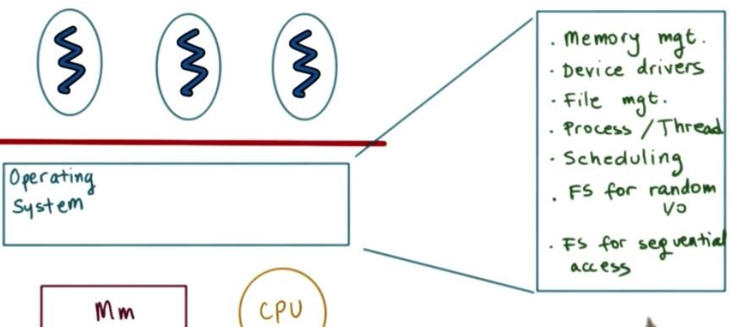
Monolithic Kernel

Slide 56
Monolithic Kernel
Pros:
More direct access to hardware for programs
Easier for processes to communicate between each other
If your device is supported, it should work with no additional
installations
Processes react faster because there isn’t a queue for processor time.
Cons:
Large install footprint Large memory is needed
Less secure because everything runs in supervisor mode

Slide 57
MicroKernel
In a Microkernel architecture, the core functionality is
isolated from system services and device drivers.
This architecture allows some basic services like device
driver management, file system etc. to run in user space.
This reduces the kernel code size and also increases the security and stability of OS as we have minimum code running in kernel.
Examples of operating systems that use a microkernel are - QNX, Integrity, PikeOS, Symbian, L4Linux, Singularity, K42, Mac OS X, HURD, Minix, and Coyotos.

Slide 58
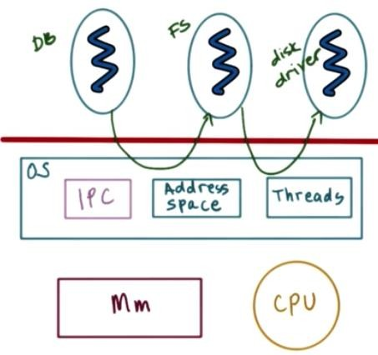
MicroKernel

Slide 59
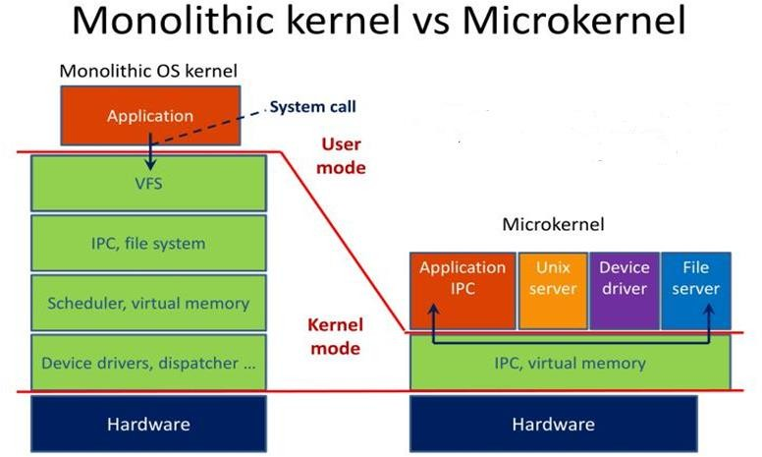
Types of Kernel

Slide 60
MicroKernel
Pros
Portability
Small install footprint Small memory Security
Cons
Hardware is more abstracted through drivers
Hardware may react slower because drivers are in user
mode
Processes have to wait in a queue to get information
Processes can’t get access to other processes without waiting

Slide 61
HybridKernel
Hybrid kernels have the ability to pick and choose what they want to run in user mode and what they want to run in supervisor mode.
Device drivers and file system I/O will be run in user mode while IPC and server calls will be kept in the supervisor mode.
This require more work of the hardware manufacturer because all of the driver responsibility is up to them.

Slide 62
Hybrid Kernel
Pros
Developer can pick and choose what runs in user mode and
what runs in supervisor mode
Smaller install than monolithic kernel
More flexible than other models
Cons
Processes have to wait in a queue to get information
Processes can’t get access to other processes without waiting
Device drivers need to be managed by user

Slide 63
Interrupts
An interrupt
is a signal from a device attached to a
computer or from a program within the computer that causes the main program that operates the computer (the operating system) to stop and figure out what to do next.
Interrupts can be of following type:
Generated by Hardware (Hardware Interrupt) Generated by Software (Software Interrupt)

Slide 64
Hardware Interrupt
Hardware interrupts are used by devices to communicate that they require attention from the operating system.
Hardware interrupts by sending signal to CPU via
system bus.
Hardware interrupts are referenced by an interrupt number.
These numbers are mapped with hardware that created the interrupt. This enables the system to monitor/understand which device created the interrupt and when it occurred.

Slide 65
Software Interrupt/ Trap
Interrupt generated by executing a instruction.
Software interrupts by a special operation called a System Call or Monitor Call.
Exp: 1. cout in C++ is a kind of interrupt because it would make a system to print something.
2. division by zero

Slide 66
Basic steps when interrupt occurs:
Interrupt Occurred?
H/w Transfers control to OS
OS preserves current state of process by using Registers and Program counter
Determine which kind of interrupt has occurred and Provides resources
When interrupt is executed, address is loaded to program counter and interrupted services are resumed.

Slide 67
I/O Interrupt
Once the I/O is started, 2 kind of interrupts may arise:
Synchronous interrupt (I/O): The control is
transferred to the user process when I/O completes.
Asynchronous interrupt (I/O): Returns control to user process without waiting for I/O to complete.

Slide 68
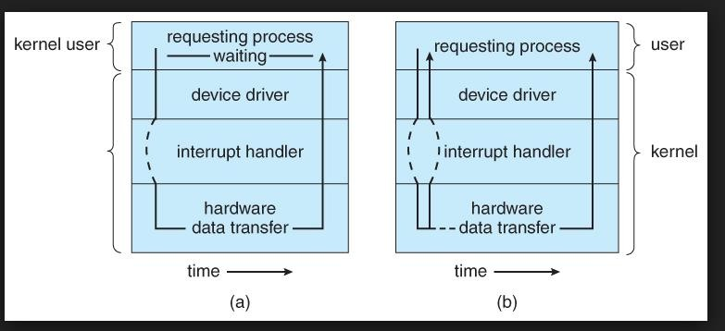
(a) Synchronous
(b) Asynchronous

Slide 69
Waiting of I/O may be accomplished in 2 ways:
Wait: it let the CPU wait till the next interrupt.
Loop: Loop continues until interrupt is active.

Slide 70
System Calls
Allow user-level processes to request services of the operating system.
It provides a way in which program talks to the operating system.
Why system calls are required?
It is a request to the operating system to perform some activity.
It is a call to the kernel in order to execute a specific function
that controls a device or executes a instruction.
A system call looks like a procedure call

Slide 71
Accessing System Calls
System calls are accessed by programs via a high-level Application Program Interface (API) (provides run time environment)
System calls are implemented via API, API’s interact with kernel of OS.

Slide 72
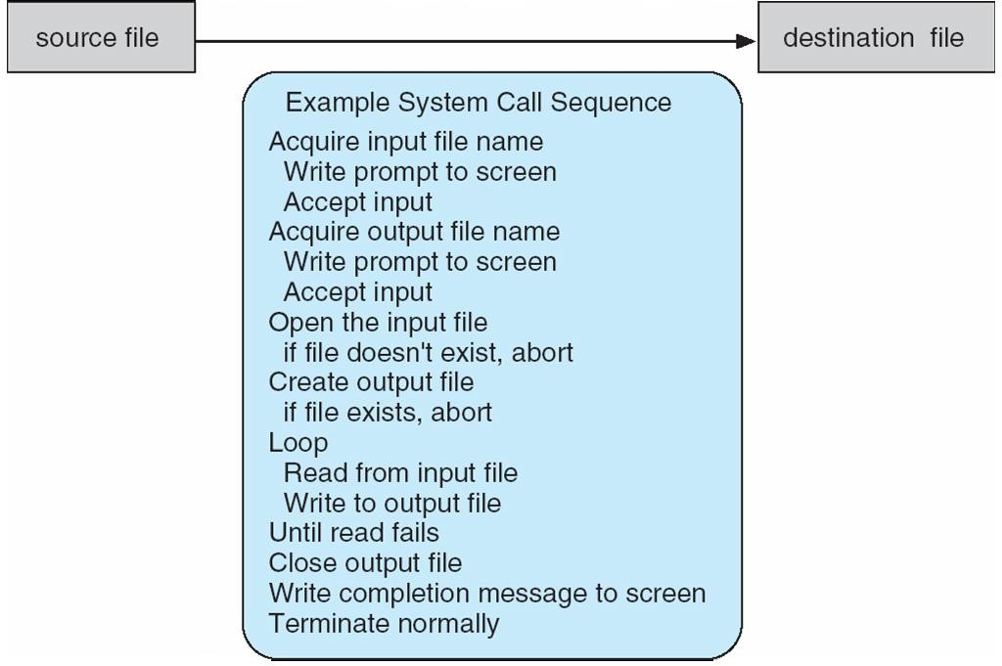
Example of System Calls
System call sequence to copy the contents of
one file to another file

Slide 73
System Call Implementation
A number is associated with each system call
System-call interface maintains a table indexed according to these numbers
The system call interface invokes intended system call in OS kernel and returns status of the system call with a return value.
The caller needs to know nothing about how the system call is implemented
Just needs to obey API and understand what OS will do as a result call
Most details of OS interface hidden from programmer by API

Slide 74
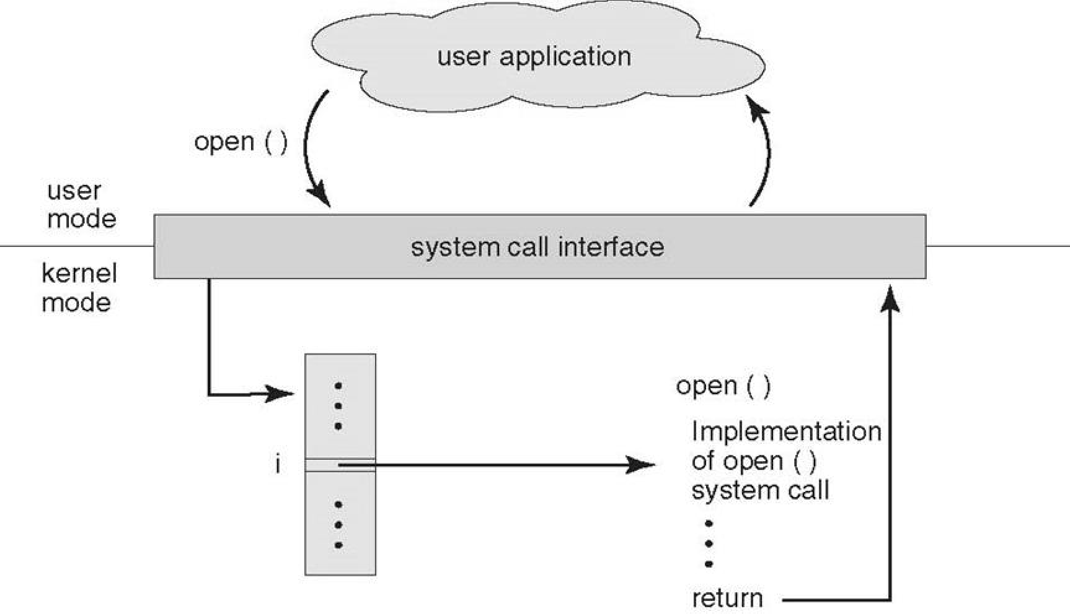
API – System Call – OS Relationship

Slide 75
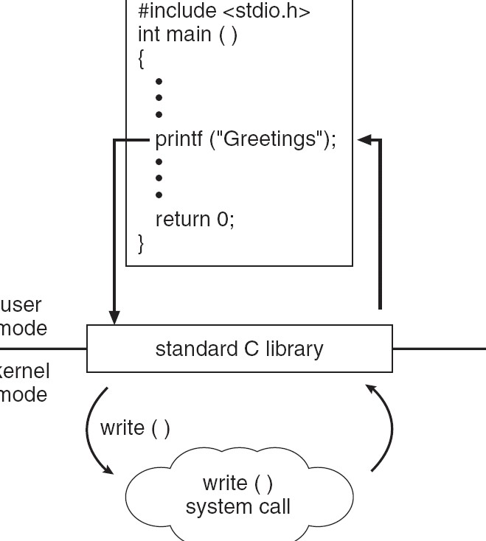
Standard C Library Example
C program invoking printf() library call, which calls
write() system call

Slide 76
System Call Dispatch
Kernel assigns system call number to each system number
Kernel initializes system call table, mapping system call number to functions implementing the system call
User process sets up system call number and arguments
User process runs

Slide 77
System Call Dispatch
Hardware switches to kernel mode and calls kernel’s interrupt handler for user process (interrupt dispatch)
Kernel looks up syscall table using system call number
Kernel calls/invokes the corresponding function
Kernel returns by running interrupt return and processing the actual program.

Slide 78
Types of System Calls
5 Categories
Process Control
end, abort load, execute create process,
terminate process
get process attributes,
set process attributes
wait for time
wait event, signal event allocate and free
memory
File Management
create file, delete file open, close file
read, write, reposition get and set file
attributes

Slide 79
Types of System Calls (Cont.)
Device Management
request device, release device read, write, reposition
get device attributes, set device attributes
logically attach or detach devices
Information Maintenance
get time or date, set time or date get system data, set system data
get and set process, file, or device attributes
Communications
create, delete communication connection
send, receive messages
transfer status information
attach and detach remote devices

Slide 80
System Call Implementation
HLL provide System Call Interface
Program makes API Call (application programming interface)
API trapped by RTL (run time library)
RTL places system calls in register
Places parameters in specific
locations and Completes System Call

Slide 81
Q1. Who controls the execution of programs to prevent errors and improper use of computer?
Resource allocator
Control Program
Hardware
None of the above

Slide 82
Q2. The operating system switches from user mode to kernel mode so the mode bit will change from?
0 to 1
1 to 0
Remain constant
None

Slide 83
Q3. In which type of operating system users do not interact directly with the computer system?
Multiprogramming operating systems
Multiprocessing operating systems
Batch operating systems
Distributed operating systems

Slide 84
Ans 3) c

Slide 85
Q4. What is the objective of multiprogramming operating systems?
Maximize CPU utilization
Switch the CPU among processes
Achieve multitasking
None of the above

Slide 86
Ans4. a)

Slide 87
Q5. Who signalled for the occurrence of an event either from the hardware or the software?
Bootstrap program
Interrupt
Disk Controller
CPU

Slide 88
Ans5: b

Slide 89
Q6. In which type of I/O interrupts the control return to the user program after the completion of I/O operation?
Synchronous I/O interrupts
Asynchronous I/O interrupts
System Call
Hardware

Slide 90
Ans 6) a

Slide 91
Q7: The device-status table contains
each I/O device type
each I/O device state
each I/O device address
all of the above
(d)

Slide 92
Ans 7 (d)

